Slide 1


Cyber Security Language Models
Adapting Cyber Defense to the Advance of AI
© 2025 Athena Software Group Inc. Confidential & Proprietary. Do not distribute without express permission.
By Peter J Worth Jr
President & CEO, Athena Software Group

Slide 2

01
Mission Statement
02
Market Opportunity
ASG Overview
03
Who we are and what we do
04
Products & Services
05
Leadership Team
06
Financial Model

Slide 3
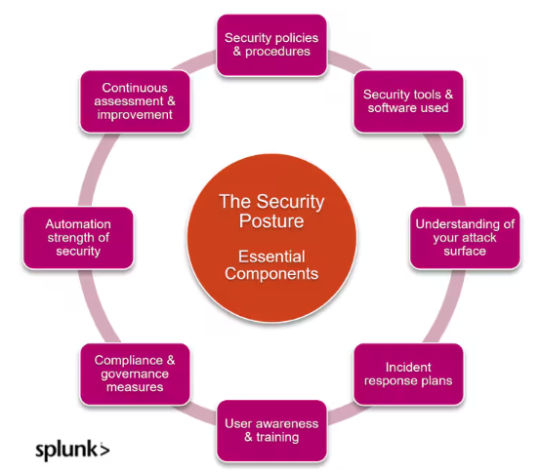
Cyber Security Posture
The stronger and more resilient your security posture, the lower your cyber risk and greater your cyber-resilience.
cybersecurity posture is a measure of an organization's ability to protect against and respond to cyber threats.
Comprehensive evaluation - assess readiness to handle cyber threats, influenced by effective security policies, staff training and incident response.
Risk vs posture - understanding the difference between cybersecurity risk (potential threats and vulnerabilities) and posture (defensive capabilities)
Interdependence and impact - as cybersecurity posture strengthens, the organization's overall risk decreases, reflecting enhanced defensive capabilities.

Slide 4
Foundational Use Cases for Cyber Security Language Models
1. Threat Detection and Anomaly Identification
LLMs can analyze extensive logs, network events, and telemetry data, recognizing subtle patterns indicative of cyber threats or anomalies. They provide contextual understanding of suspicious activity, correlating seemingly unrelated events to identify potential breaches or attacks.
2. Security Incident Response Automation
Automating responses to standard security incidents by interpreting alerts, analyzing context, and suggesting or executing initial remediation steps. Streamlining the triage process to quickly prioritize critical threats based on context derived from past incidents.
3. Vulnerability Assessment and Management
Parsing security bulletins, advisories, and CVE databases to summarize and highlight critical vulnerabilities relevant to an organization's infrastructure. Generating actionable mitigation strategies and prioritization recommendations tailored to the organization's specific technologies and risk profile.
4. Phishing and Social Engineering Detection
Identifying suspicious patterns in emails, text messages, and other communication platforms by leveraging natural language understanding to detect phishing, impersonation, or manipulative techniques. Educating users by generating realistic phishing simulations or context-aware cybersecurity training content.
5. Cybersecurity Documentation and Compliance Automation
Generating compliance reports, incident documentation, and audit logs automatically, reducing the manual burden associated with regulatory requirements (e.g., GDPR, NYSDFS 23 NYCRR 500).Assisting in the interpretation of regulatory texts, summarizing complex cybersecurity requirements, and suggesting compliance actions.
6. Intelligent Threat Intelligence
Parsing vast amounts of threat intelligence data to provide concise, actionable insights tailored to an organization's unique threat landscape. Automatically generating intelligence reports or briefings about emerging threats and their implications for the organization.
7. Cybersecurity Assistant (Chatbot/Virtual Analyst)
Serving as a first-line assistant that provides cybersecurity support, answering questions about policies, procedures, recent threats, or incident response guidelines. Assisting cybersecurity analysts by summarizing logs, incidents, or threat intelligence data to expedite informed decision-making.
8. Code and Software Security Analysis
Reviewing code repositories, documentation, and logs to identify potential security weaknesses, such as insecure coding patterns, hardcoded credentials, or risky configuration settings. Suggesting secure coding practices and generating contextual remediation steps.
9. Enhanced SIEM and Log Analysis
Integrating LLMs with Security Information and Event Management (SIEM) platforms to provide enhanced semantic understanding of security logs, correlate events, and reduce false positives through natural language analysis. Improving root-cause analysis by interpreting event logs and contextualizing security events.
10. Retrieval-Augmented Generation (RAG) for Security
Employing RAG models to access up-to-date cybersecurity knowledge bases or internal documentation, providing timely, accurate, and contextually relevant answers during security incidents or routine operations.
Threat intelligence application is the target for first phase, with incident response, compliance automation, analysts support and RAG integration (1, 2, 5, 7 and 10) as potential targets thereafter. Models must be trained on Cyber security data (public + private) and then plugged into the environment for proper contextualization and customization of output

Slide 5
Cyber Security Language Models
Model Name | Introduced | Developer(s) | Base Model | Training Methodology | Targeted Domains
CyberPal.AI | Aug-24 | Matan Levi et al. | Not specified | Instruction tuning with SecKnowledge dataset; evaluated using SecKnowledge-Eval benchmark | Threat hunting, malware analysis, vulnerability assessment, incident response
Llama-Primus | Feb-25 | Trend Micro AI Lab | Llama-3.1-8B-Instruct | Continual pretraining on cybersecurity corpus; instruction fine-tuning with curated QA tasks | Cyber threat intelligence, vulnerability classification, security certification preparation
SecBERT | 2022 | jackaduma | BERT | Pretrained from scratch on cybersecurity texts including APTnotes, Stucco-Data, CASIE, and SemEval-2018 Task 8; custom vocabulary | Threat intelligence, NER, text classification, semantic understanding, Q&A in cybersecurity context
SecureBERT | 2022 | Ehsan Aghaei et al. (UNC Charlotte) | BERT | Continual pretraining with customized tokenizer on large corpus of cybersecurity text | Cyber threat intelligence, cyber automation, phishing detection, code and malware analysis, intrusion detection
CTI-BERT | Dec-23 | IBM T.J. Watson Research Center | BERT | Pretrained from scratch on high-quality cybersecurity corpus containing CTI reports and publications | Cyber threat intelligence extraction, security entity (IoCs) extraction, attack technique (TTPs) classification
SecurityLLM | Jan-25 | ZySec-AI | Zephyr-7b-beta | Direct Preference Optimization (DPO) training across 30+ security domains | Threat analysis, compliance verification, security architecture reviews, SOC operations, risk management
SecurityBERT | Jun-23 | Mohamed Amine Ferrag et al. | BERT | Privacy-preserving encoding technique (PPFLE) combined with Byte-level Byte-Pair Encoder (BBPE) Tokenizer; trained on IoT data | Cyber threat detection in IoT/IIoT devices
Variety of models have been introduced with a broad range of test methodologies and applications. Technology development and adoption is still in its infancy.

Slide 6

CyBERT (2021)
Contextualized Embeddings for the Cybersecurity Domain
The primary contribution of this paper is providing the security community with an initial fine-tuned BERT model that can perform a variety of cybersecurity-specific downstream tasks with high accuracy and efficient use of resources.
We create a cybersecurity corpus from open-source unstructured and semi-unstructured Cyber Threat Intelligence (CTI) data and use it to fine-tune a base BERT model with Masked Language Modeling (MLM) to recognize specialized cybersecurity entities.
We evaluate the model using various downstream tasks that can benefit modern Security Operations Centers (SOCs).
The fine-tuned CyBERT model outperforms the base BERT model in the domain-specific MLM evaluation. We also provide use-cases of CyBERT application in cybersecurity based downstream tasks.
P. Ranade, A. Piplai, A. Joshi and T. Finin, "CyBERT: Contextualized Embeddings for the Cybersecurity Domain," 2021 IEEE International Conference on Big Data (Big Data), Orlando, FL, USA, 2021, pp. 3334-3342, doi: 10.1109/BigData52589.2021.9671824.

Slide 7

Pretraining vs Finetuning
The general process of creating an LLM includes pretraining and finetuning. The term "pre" in "pretraining" refers to the initial phase where a model like an LLM is trained on a large, diverse dataset to develop a broad understanding of language
This pretrained model then serves as a foundational resource that can be further refined through finetuning, a process where the model is specifically trained on a narrower dataset that is more specific to particular tasks or domains.

Slide 8

Instruction Tuning
Finetuned Language Net (FLAN)
Whereas supervised fine-tuning trains models on input examples and their corresponding outputs, instruction tuning augments input-output examples with instructions, which enables instruction-tuned models to generalize more easily to new tasks.
"Instruction tuning", which finetunes language models on a collection of tasks described via instructions, substantially boosts zero-shot performance on unseen tasks.
Methods differ based on how the instruction tuning data is constructed.
Finetuned Language Models Are Zero-Shot Learners; Wei et al. 2022

Slide 9


Adapting LLMs for Cyber Security
Hybrid approaches are proving to be the most effective and involve a combination of traditional finetuning strategies along with the instruction based tuning and RLHF. Source: https://gradientflow.com/maximizing-the-potential-of-large-language-models/

Slide 10
PEFT: Parameter Efficient Fine Tuning
PEFT stands for Parameter Efficient Fine-tuning.
ML models are essentially complex mathematical equations with numerous coefficients or weights.
These coefficients are responsible for the model behavior and make it capable of learning from data.
During training of ML models, we adjust these coefficients to minimize errors and make accurate predictions.
In case of LLMs, which can have billions of parameters, and changing all of them during training can be computationally expensive and memory-intensive.
PEFT, as a subset of fine-tuning, takes the parameter efficiency seriously.
Instead of altering all the coefficients of the model, PEFT selects a subset of them.
It helps us significantly reducing the computational and memory requirements.

Slide 11


Slide 12
PEFT: Parameter Efficient Fine Tuning
LoRA and QLoRA for Coefficient Selection
LoRA (Low-Rank Adoption):
It is a technique exploits the fact that some weights have more significant impacts than others. In LoRA, the large weight matrix is divided into two smaller matrices by factorization.
We reduce the number of coefficients that need adjustment, making the fine-tuning process more efficient.
QLoRA (Quantization + Low-Rank Adoption):
Quantization involves converting high-precision floating-point coefficients into lower-precision representations, such as 4-bit integers.
Quantization offers a solution by reducing the precision of these coefficients.
For instance, a 32-bit floating-point number can be represented as a 4-bit integer within a specific range. This conversion significantly shrinks the memory footprint.

Slide 13
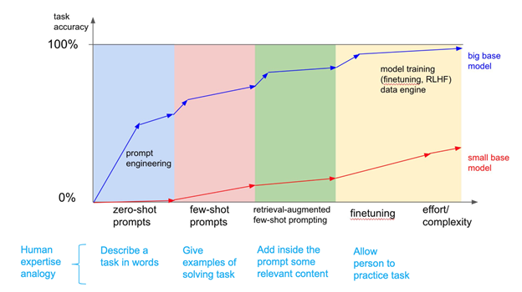
Evolution of Finetuning Approaches
https://www.signalfire.com/blog/comparing-llm-fine-tuning-methods

Slide 14

Tuning Approaches

Slide 15
Different Training Strategies
Aspect | Traditional Fine-Tuning | Instruction Tuning | Hybrid Approach
Description | Adapting a general-purpose model to cybersecurity by updating weights on a large unlabeled/labeled domain corpus | Adapting a model to follow explicit instructions in natural language format across various cybersecurity tasks | Combines traditional fine-tuning on a domain corpus followed by instruction tuning or integrates both into a single multi-objective training setup
Input Format | Raw cybersecurity texts (blogs, CVEs, advisories) | Tuples like (“Map this CVE to MITRE ATT&CK”, CVE text → expected answer) | First: domain texts → corpus adaptation; then: curated instructions → multi-task generalization
Training Objective | Masked Language Modeling (MLM) or Causal Language Modeling (CLM); optionally with classification/regression heads | Supervised generation / classification using cross-entropy loss | Pretrain or adapt with MLM, then instruction tune; or mix the objectives (e.g., multi-task loss)
Best For | Embedding learning, classification, entity recognition, internalizing domain-specific syntax and jargon | Multi-turn reasoning, question-answering, structured task execution (e.g., IOC extraction, root cause summarization) | Use cases needing both strong domain understanding and complex task following (e.g., SOC assistant, security triage)
Sample Cyber LLMs | • CTI-BERT (IBM) • SecureBERT (UNC) • SecBERT (jackaduma) • SecurityBERT (IoT) | • CyberPal.AI • Llama-Primus • SecurityLLM • Sec-Gemini v1 (RAG + instruction) | • Llama-Primus (base → merged) • CTI-BERT + instruction adapters • CyberPal.AI w/ SecKnowledge → SecKnowledge-Eval loop
Strengths | ✔ Captures nuanced cybersecurity terminology ✔ Improves base model for domain-specific NLP tasks | ✔ Generalizes across task types ✔ Interpretable and human-aligned ✔ Easier downstream zero-shot/few-shot use | ✔ High performance in both static understanding and reasoning ✔ Flexibility across tasks ✔ Lower label dependency if pretrained well
Weaknesses | ✖ May not generalize well to unfamiliar task formats ✖ Doesn’t teach “task framing” | ✖ Requires high-quality curated instruction data ✖ May hallucinate if not grounded | ✖ Expensive and complex training pipeline ✖ Risk of forgetting if improperly scheduled
Compute Requirements | • Requires moderate GPU resources for continual pretraining (e.g., 8x A100 for 100M tokens) • Good fit for distributed training | • Typically less data but more curated, though larger sequence lengths and decoder-based models (e.g., LLaMA, GPT) may demand more memory • 8x A100 for ~20K examples | • Highest resource requirement: pretraining on corpus (TPU/8x A100) + instruction finetuning (decoder model, RAG-enabled, ~24GB GPU RAM or more)
Parameter Efficient Tuning | Supported via LoRA, Adapters (sparse updates) | Works well with PEFT (e.g., QLoRA, LoRA), especially for instruction-tuning-friendly architectures | Common hybrid practice: LoRA for instruction head + frozen backbone or adapter fusion
Instruction-Awareness | ❌ Model is unaware of instructions explicitly | ✅ Instruction-following enabled | ✅ Instruction-aware + domain-knowledge enriched
Fine-Tuning Duration | Long (10–40 hours for 100M tokens depending on model size) | Medium (4–12 hours for 20K–100K examples depending on format) | Longest (20–80 hours if running pretrain + instruction + eval loop with RAG)

Slide 16

Project Lifecycle

Slide 17


Slide 18
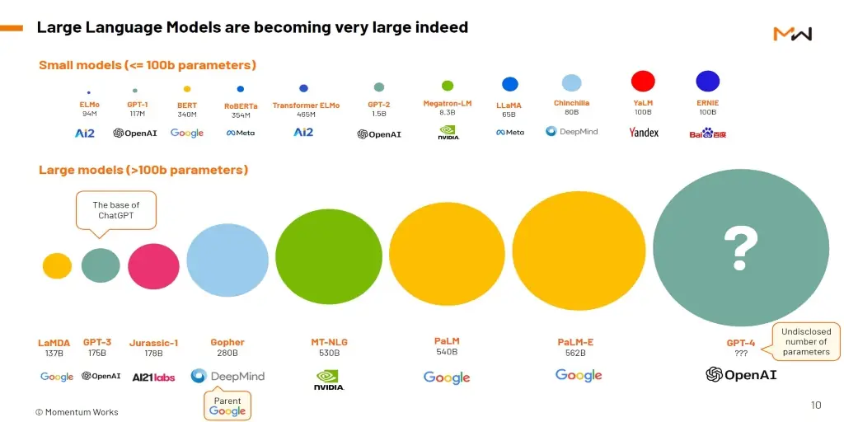

Slide 19

Finetuning strategy to be aligned with optimal compute requirements

Slide 20
Evaluating the Performance of Cyber Security LLMs
Benchmarks for Cyber Security Language Models
Benchmark | Organization / Authors | Open Source | Cybersecurity Domain | Key Tasks | Introduced In
CTIBench | University of Waterloo & AI4Sec | Yes (GitHub, Hugging Face) | Threat Intelligence, Vulnerability Analysis, Threat Attribution | CTI-MCQ, CTI-RCM, CTI-VSP, CTI-TAA | Jul-24
SecKnowledge-Eval | CyberPal.AI (Authors of SecKnowledge Paper) | No (Contact authors) | Instruction Following, Threat Analysis, Security Reasoning | Threat/attack pattern understanding, contextual security tasks | Aug-24
CyberSecEval 2 | Meta AI | No | Offensive & Defensive Cybersecurity, LLM Risk Assessment | Malicious instruction handling, threat detection, security training evaluation | Apr-24
Sophos Benchmark Suite | Sophos AI | No | SOC Operations, Incident Handling | Incident summarization, SQL generation, severity rating | Mar-24
SECURE | Rochester Institute of Technology | Partially (some datasets) | ICS Security, Threat Reasoning | Knowledge extraction, understanding, reasoning in ICS scenarios | May-24
Cybench | CTF Community Researchers | Limited (some CTF challenges) | Offensive Security, Exploit Development | CTF task solving, vulnerability discovery, exploit execution | Jun-24
Evaluation of open-source benchmarks, applicability to threat intelligence specifically and potentially expanding and creating our own benchmark that speaks to the capabilities around Flashpoint Threat Intel specifically.

Slide 21
Flashpoint Integration
Integrating Flashpoint Ignite data into a Stand- Alone Cyber Security Trained LLM

Slide 22
Cyber Security Use Cases leveraging Flashpoint Ignite
Actionable Threat Intelligence
  Real-time alerts on emerging cyber threats
  Indicators of Compromise (IOCs) and threat actor intelligence
  Curated insights into darknet and deep web activities
Risk Management and Vulnerability Assessment
  Detailed vulnerability information, CVE analysis, exploit availability
  Predictive insights to prioritize patching and security remediation
Cybercrime Monitoring
  Monitoring dark web forums, marketplaces, and illicit communities
  Early detection of credential leaks, fraudulent activities, and malicious campaigns
Integrations and API
  Seamless integrations with existing security stacks (SIEM, SOAR, endpoint security solutions)
  Rich API for threat feeds and automation workflows
Malware & Threat Actor Profiling
  Detailed threat actor reports, attribution, and behavior analysis
  Insights into geopolitical threats, hacktivism, organized crime, and nation-state actors
  Latest Malware exploits & Attack Vectors
Real-Time Threat Intelligence Analysis & Summarization
Automatically generate concise summaries of new threats and intelligence reports.
Reduces analyst time spent reviewing large threat intel documents.
Automated Incident Triage & Root Cause Analysis
Objective: Leverage the LLM to swiftly analyze incidents by correlating alerts with known vulnerabilities, threat actors, and recent intelligence.
Benefit: Accelerates response time and provides immediate contextual understanding.
Proactive Vulnerability & Exploit Prioritization
Objective: Analyze CVEs, exploit availability, and real-world threat activity to prioritize patches and responses.
Benefit: Improves security posture by aligning efforts with real-world risk.
Threat Actor Attribution & Behavioral Analysis
Objective: Generate threat actor profiles from detailed data, recognizing patterns, tools, and tactics.
Benefit: Enhances attribution accuracy and threat prediction capabilities.
Expected Benefits
Accelerate security operations by significantly reducing the time-to-analysis for threat intelligence.
Enhance analytical accuracy through real-time integration with evolving threat data.
Improve cybersecurity decision-making, prioritization, and proactive response.

Slide 23

Finetuning And Integration Strategy
Given Ignite’s data-rich and specialized threat-intel environment, the ideal fine-tuning approach is a Hybrid Fine-Tuning + Instruction Tuning strategy.
Step 1: Domain Corpus Preparation
Data Sources; Flashpoint Ignite threat intelligence feeds (dark web forums, CVEs, threat actor reports, incident summaries). Structured indicators (IOC, TTPs, MITRE ATT&CK mappings).
Fine-Tuning Objective: Masked Language Modeling (MLM) to internalize threat intelligence vocabulary and cybersecurity-specific context.
Step 2: Curated Instruction Dataset Creation
Instructions Examples:
"Summarize this threat report.”
"Attribute this incident to a known threat actor.”
"Identify potential impacts of this CVE.”
"Extract all relevant IOCs from this threat document."
Format: Structured as (Instruction, Input → Desired Output) tuples.
Step 3: Instruction Tuning
Objective: Enable the LLM to follow security-specific instructions.
Methodology: Supervised fine-tuning with instruction tuples, cross-entropy loss on generated outputs.
Step 4: Integration of Retrieval-Augmented Generation (RAG)
Combine the LLM with Ignite’s real-time data retrieval via embeddings and vector stores.
Provide the model with external real-time context (latest threats, CVEs, etc.) to answer queries more accurately.

Slide 24
LLM Model& Context Integration & Compute Requirements
Leverage state of the art Cyber Security LLMs and finetune against Flashpoint data using optimized finetuning strategies
Leverage state of the art Cyber Security LLMs with robust instruction-following capabilities and retrieval augmentation compatibility:
Llama-Primus or Sec-Gemini v1 (instruction-tuned, cybersecurity-focused), or
Alternative: Zephyr-7b-beta for efficiency.
PEFT: Utilize LoRA (Low-Rank Adaptation) or adapters for efficient updates and rapid deployment.
RAG Integration (Inference & Retrieval):
Utilize vector stores (e.g., Neo-4j) for embedding-based real-time retrieval of environment context. (Minimal additional GPU overhead, primarily inference-focused.)
Compute Requirements (roughly)
Continual Pretraining (MLM):
Moderate-to-large GPU resources (e.g., 8x NVIDIA A100 GPUs).
Expected training duration: ~10–40 hours depending on corpus size (50M–200M tokens).
Instruction Tuning:
4–12 hours on 8x NVIDIA A100 GPUs for datasets of 20K–100K instruction tuples.

Slide 25

Appendix
Parameter Efficient Tuning Methods

Slide 26
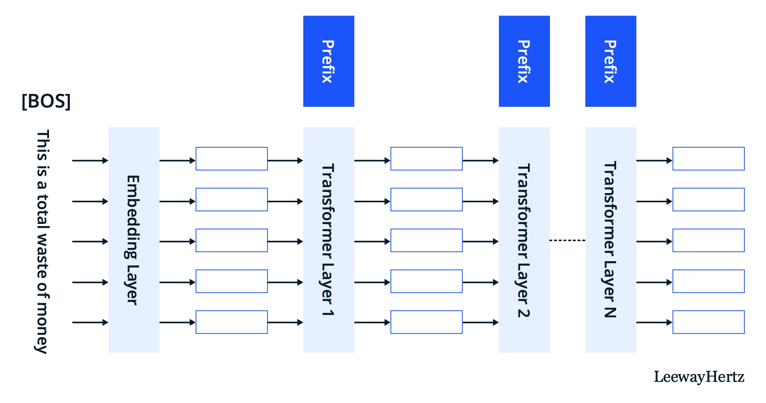
Prefix Tuning
https://www.leewayhertz.com/parameter-efficient-fine-tuning/

Slide 27

Prompt Tuning
https://www.leewayhertz.com/parameter-efficient-fine-tuning/

Slide 28
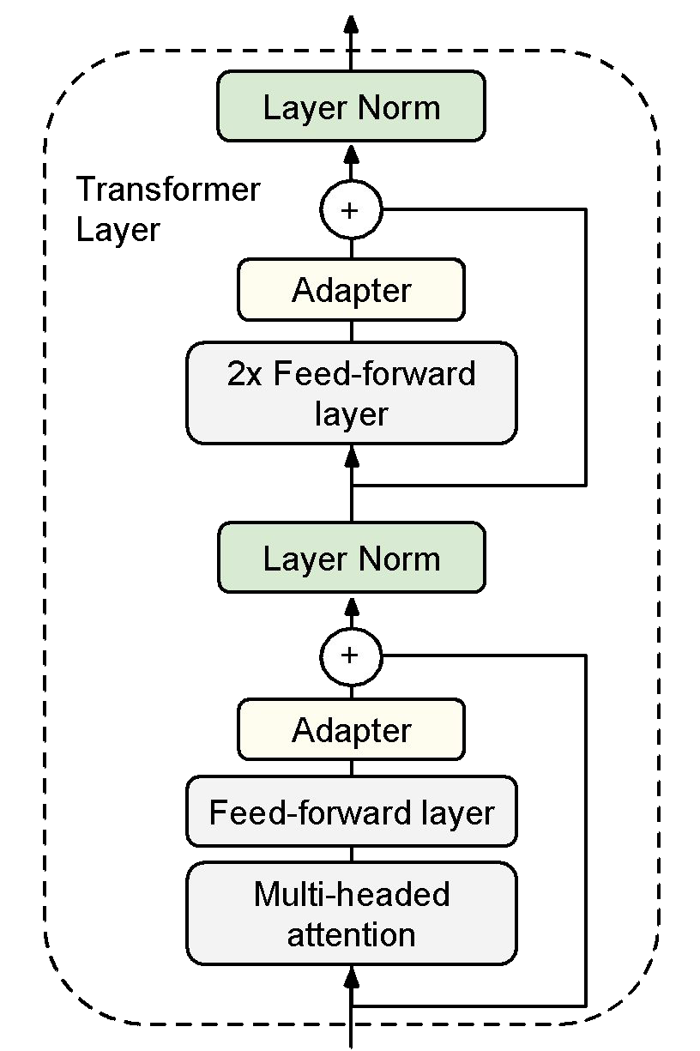
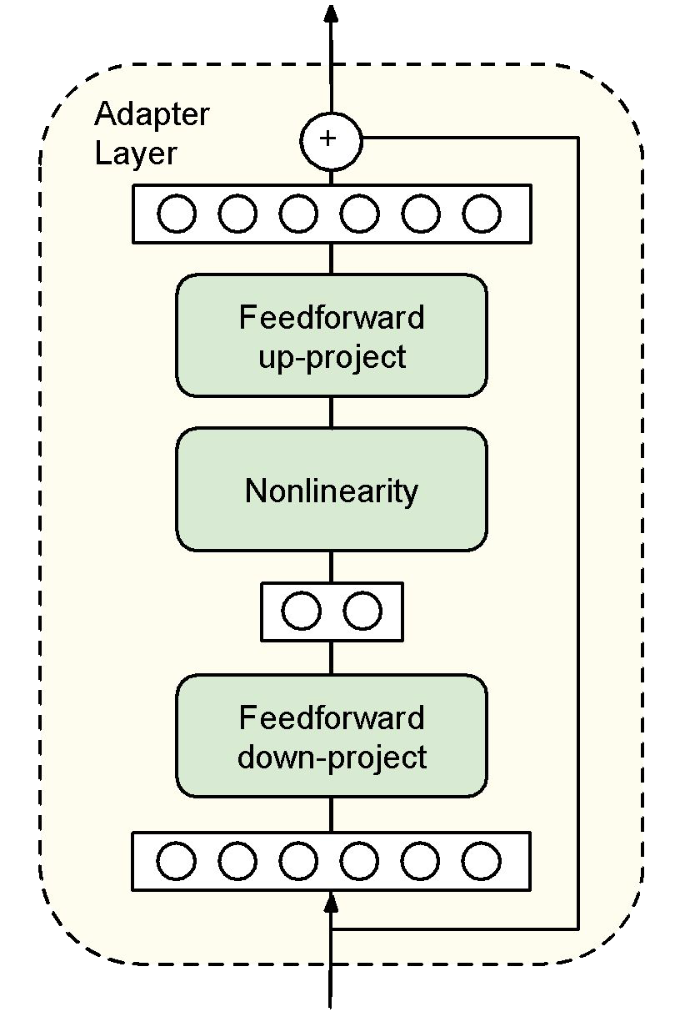
What are adapters?
Adapters are new modules are added between layers of a pre-trained network.
The original model weights are fixed; just the adapter modules are tuned.
The adapters are initialized such that the output of the adapter-inserted module resembles the original model.
“Parameter-Efficient Transfer Learning for NLP.” Houslby et al. 2019.

Slide 29
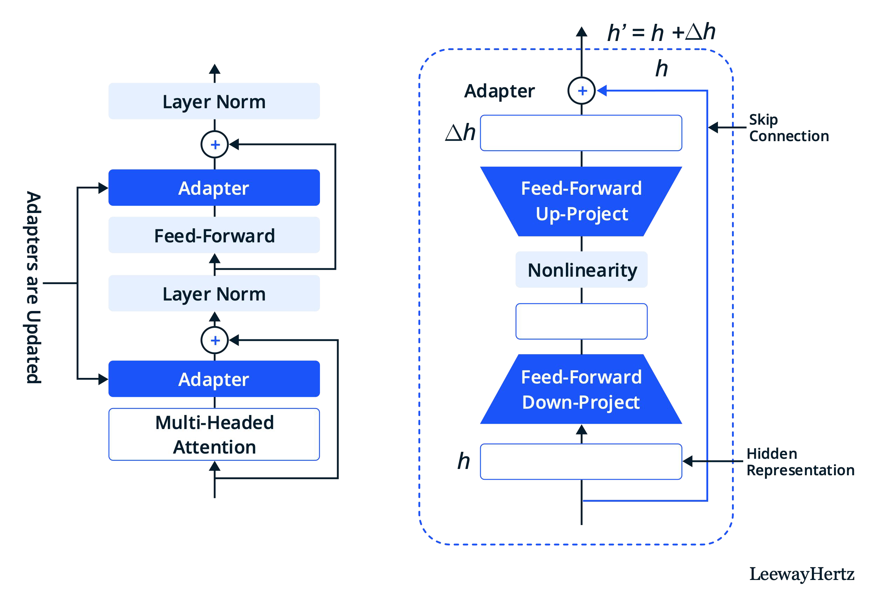
Adapters: adding in new trainable layers
https://www.leewayhertz.com/parameter-efficient-fine-tuning/

Slide 30
LoRA: Low Rank Adaption
Intuition: It’s not just the model weights that are low rank, updates to the model weights are also low-rank.
LoRA freezes the pretrained model weights and injects trainable rank decomposition matrices into each layer.
Like DiffPruning, we are learning a delta to apply to each weight. In the case of LoRA, this delta has been re-paramaterized to be lower dimension than the original model parameters.
In practice, LoRA only adapts the attention weights and keeps the rest of the Transformer as-is.
“LoRA: Low-Rank Adaptation of Large Language Models.” Hu et al. 2021.

Slide 31


LoRA: injecting trainable rank decomposition matrices
https://www.leewayhertz.com/parameter-efficient-fine-tuning/

Slide 32

Athena Software Group
Best in Class, AI Enabled, security solutions for Enterprise application providers.

Slide 33


Glaukopis (γλαυκῶπις) the “grey eyed one”

Slide 34
Athena Software Group Inc.
A company founded under the principles of integrating Cyber Security best practices, high end custom enterprise software and artificial intelligence (LLMs).
Athena Software Group brings together some of the best minds in computer science, cyber defense and SaaS to design solutions specifically for application service providers.
We take a fully integrated and analytical approach to Cyber Security defense, knowing through experience that the best Cyber Defense strategies arise from providing the best analysts with the best tools from within a fully integrated cyber security infrastructure that is informed by the latest cyber and t
We intend to set a new bar in Cyber defense by providing tools along the entire Cyber defense stack which are fully integrated with Cyber specific trained LLMs that both understand the global threat landscape AND are informed by the technical specifications which underpin the application specific infrastructure environment facilitating higher quality, more rapid and informed outcomes with respect to threat and anomaly detection, response management, vulnerability management and compliance.

